Slide 1

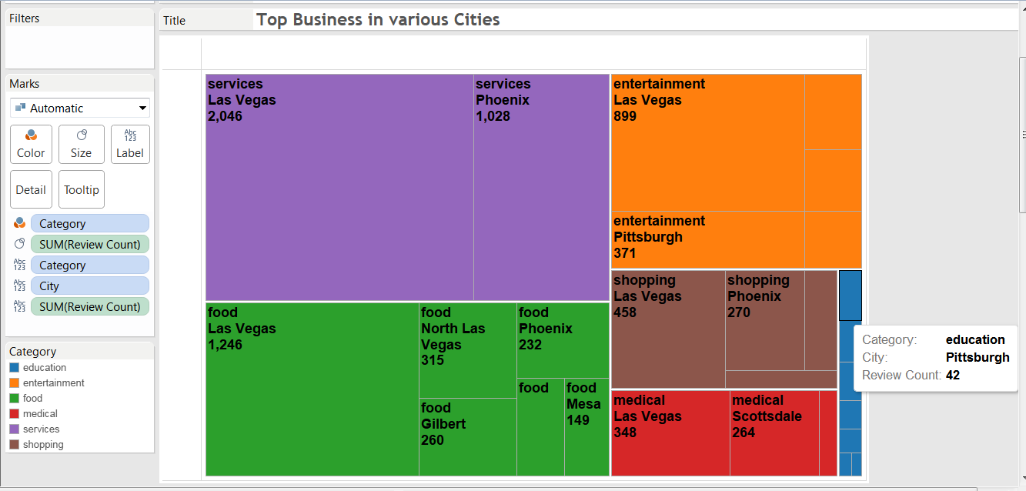
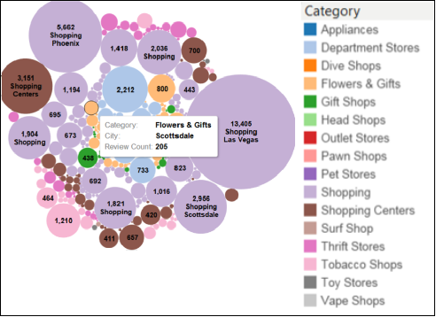
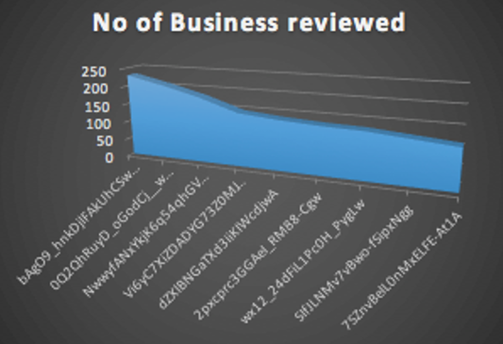
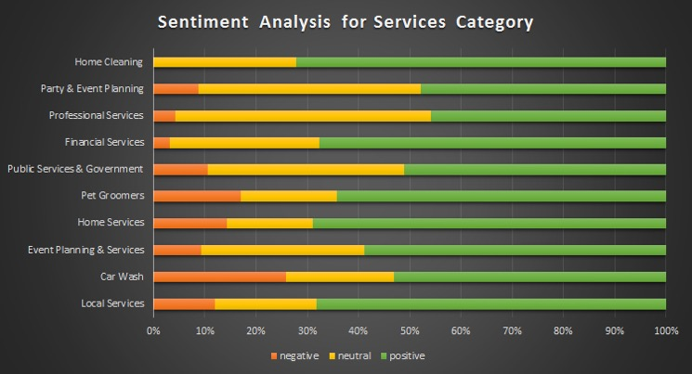
Local Business Data Analysis
Ruchi Singh, Yashaswi Ananth, Mahsa Tayer Farahani | Dr. Jongwook Woo | California State University, Los Angeles
Problem / Question
Data Specifications
Visualizations
To provide insightful analytics from large datasets obtained from the internet about the existing Local Business.
IBM Bluemix Components | Management Nodes | 1
 | vCPU | 12
 | RAM (GB) | 48
 | Data Nodes | 1
 | vCPU | 4
 | RAM (GB) | 24
 | Data Disk | 1 TB SATA
 | CPU Speed | 2.4 GHz Intel Xeon ES-2673
Dataset Components | Local Business
 | File Type | CSV
 | File Size | 90 MB
 | Rows | 334,35
 | Columns | 108
 | Customer Reviews
 | File Type | JSON
 | File Size | 85 MB
 | Rows | 117,486
 | Columns | 10
Hypothesis
All the data in the dataset are authentic
All the local business in a city are either registered in Yelp or Google Local
Insights drawn from data collected from 2005 and 2016 is generalizes for the business
Figure. 1 Businesses categories grouped by city
Figure. 2 Count of reviews for the sub-categories of the Shopping category
Figure. 3 Maximum count of reviews made by individual users
Top Rated Food Businesses
City | Name | Reviews | Stars
Las Vegas | Art of Flavours | 359 | 5
Las Vegas | Poke Express | 315 | 5
Las Vegas | Brew Tea Bar | 306 | 5
Gilbert | Frost Gelato | 260 | 5
Las Vegas | Dutch Bros. Coffee | 241 | 5
Phoenix | Handcrafted American Fare | 232 | 5
Las Vegas | Karaoke Bar | 192 | 5
Montreal | Kem CoBa | 156 | 5
Mesa | Gelato Dolce Vita | 149 | 5
Las Vegas | Tast Crepes | 148 | 5
Reservation |  | Ambience |  | Wheelchair |  | TV |  | WiFi
Top | Low | Top | Low | Top | Low | Top | Low | Top | Low
No | No | Yes | No | Yes | No | Yes | No | Free | No
Yes | No | No | Yes | Yes | No | No | No | Free | No
Yes | No | Yes | No | No | No | No | No | Free | No
No | No | No | No | Yes | No | No | No | No | No
Yes | No | Yes | No | No | No | Yes | Yes | Free | No
Yes | No | No | Yes | Yes | No | Yes | No | Free | No
Yes | Yes | Yes | Yes | Yes | No | Yes | No | Free | Free
Yes | No | Yes | No | Yes | Yes | Yes | Yes | No | Free
Yes | Yes | Yes | Yes | No | No | Yes | Yes | Free | No
Yes | No | Yes | No | Yes | No | No | No | Free | Free
80% | 20% | 70% | 40% | 70% | 10% | 60% | 30% | 80% | 30%
Table. 1 Top rated food businesses
Project Overview
Procedure
Bottom Rated Food Businesses
City | Name | Reviews | Stars
Las Vegas | KFC | 19 | 1
Las Vegas | MCDonald’s | 17 | 1
Charlotte | Pizza Hut | 15 | 1
Chandler | Dairy Queen | 14 | 1
Maricopa | Dairy Queen | 14 | 1
Scottsdale | Food Truck Festival 2012 | 12 | 1
Pittsburgh | Pizza Hut | 11 | 1
Carnegie | Walmart | 10 | 1
Queen Creek | Burger King | 9 | 1
Surprise | Church’s Chicken | 9 | 1
We have analyzed a huge data set from Yelp and Google Local that spanned a variety of businesses such as restaurants, shopping, nightlife, medical, education, entertainment, common services, etc. in various cities across the world using Big Data.
We have tried to understand various aspects of the Local Businesses; factors driving their popularity, customer review patterns and regions that favor certain businesses the most.
Analyzing user reviews has helped us in deriving insights to achieve our objective through this project.
Acquire Data
Identification and authenticated access to Yelp and Google Local data. Transportation of 200 MB data from sources to distributed files systems.
Data Engineering
Exploring and understanding data. Removing junk data, duplicate rows, eliminating NULL values and formatting date to yyyy-mm-dd.
Analyze Data
HiveQL and Pig are the querying tools built on top of Hadoop that is used to query data within HDFS. Hive makes it useful for creating reports whereas Pig is a Procedural Data Flow language used for programming by researchers and programmers.
Interpret Data
Visualizations are generated in Tableau and Excel power view that create multi-faceted views of data and help communicate complex visualizations.
Figure. 4 Percentage of positive, neutral and negative customer reviews for the Services category
Table. 2 Bottom rated food businesses
Table. 3 Factors influencing the popularity of the food businesses
Conclusion
Using Hadoop, Hive, Pig, and Tableau enhanced the exploratory possibilities and analytics capability to store and process Big Data in parallel
Factors driving their popularity, customer review patterns, regions that favor certain businesses the most can be determined by analyzing data
Analyzing the customer sentiments based on their reviews has helped us in realizing the importance of customer satisfaction
Variables / Research
Observations
Works Cited
Controlled variables
These are kept the same throughout your experiments
Independent variable
The one variable you purposely change and test
Dependent variable
The measure of change observed because of independent variable
Decide how you will measure the change
Users tend to review the food businesses over the other categories like education, medical, shopping and services. Although categories like Education and Medical are equally important categories as Food
In every category of business maximum number of review count come from Las Vegas. Possible reason could be the huge number of tourists that visit the city every year, use the services and leave feedbacks.
More than 60% people in a city write positive reviews for the business and services they use. Las Vegas has the highest number of useful review votes.
Services businesses mostly received positive reviews from the customers and the Home cleaning department did not receive any negative feedback.
One particular user had written reviews for almost 250 different business over a span of 10 years. Further text analysis of the reviews could help us in understanding the authenticity of these reviews.
More than 70% of the top 10 food business has reservation, ambience, wheelchair facility, TV and free wifi where less than 30% of bottom 10 have the same
Apache Hadoop Project, http://hadoop.apache.org/
Apache Hive, http://hive.apache.org/
Yelp Data of HiPIC, https://s3.amazonaws.com/hipicdatasets/yelp_raw_fall_2016.csv
Yelp Review Data Set, https://docs.google.com/uc?id=0B9kspRX6SWaaMlRvREQ3NmUxOE0&export=download
GitHub Link: https://github.com/shamaahsaa/Local_Business_DataAnalysis

